Slide 1

8th Grade Math: Pre-Algebra
Unit 4, Lesson 6 Equivalent Expressions Volume 1, pg. 147

Slide 2


Benchmark
MA.8.NSO.1.3
Extend previous understanding of the Laws of Exponents to include integer exponents. Apply the Laws of Exponents to evaluate numerical expressions and generate equivalent numerical expressions, limited to integer exponents and rational number bases, with procedural fluency.
volume 1, pg. 147

Slide 3
Integrated Mathematical Thinking and Reasoning Standards
MA.K12.MTR.1.1 Actively participate in effortful learning both individually and collectively.
MA.K12.MTR.3.1 Complete tasks with mathematical fluency.
MA.K12.MTR.4.1 Engage in discussions that reflect on the mathematical thinking of self and others.
MA.K12.MTR.5.1 Use patterns and structure to help understand and connect mathematical concepts.
volume 1, pg. 147

Slide 4

Learning Target
I can determine equivalency using the laws of exponents.
volume 1, pg. 147

Slide 5

Warm-Up
volume 1, pg. 148

Slide 6

4.6.1 Warm-Up: Bell Work
Evaluate each expression. Show your work.
$\frac{{\left(−4\right)}^{2}{\left(−4\right)}^{−3}}{−4}$
${\left({\left(\frac{2}{5}\right)}^{3}\right)}^{−2}·{\left(\frac{5}{2}\right)}^{−4}$
volume 1, pg. 148
Notes:
Video Link: https://algebranation.wistia.com/medias/fi4fidi5y8

Slide 7

Exploration
volume 1, pg. 148

Slide 8

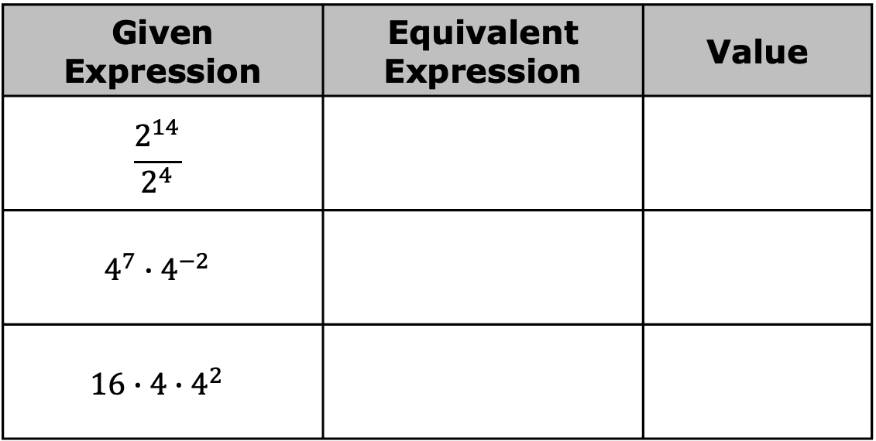
4.6.2 Exploration: Exponential Expressions with Different Bases
Three expressions are given in the table.
For each given expression, generate an equivalent expression by applying exponent laws. Then, find the value of the expression using a calculator.
Given Expression | Equivalent Expression | Value
$$\frac{2^{14}}{2^{4}}$$
$$4^{7}∙4^{−2}$$
$$16∙4∙4^{2}$$
volume 1, pg. 148

Slide 9
Discuss your results with your partner. What do you notice about the three expressions?
volume 1, pg. 148

Slide 10

Guided Instruction
volume 1, pg. 149

Slide 11
4.6.3 Guided Instruction: Rewriting Expressions with Different Bases
Exponent laws can be applied to exponents with the same base. However, sometimes a base can be rewritten to create a common base when perfect squares, cubes, fourths, etc. are present.
volume 1, pg. 149

Slide 12
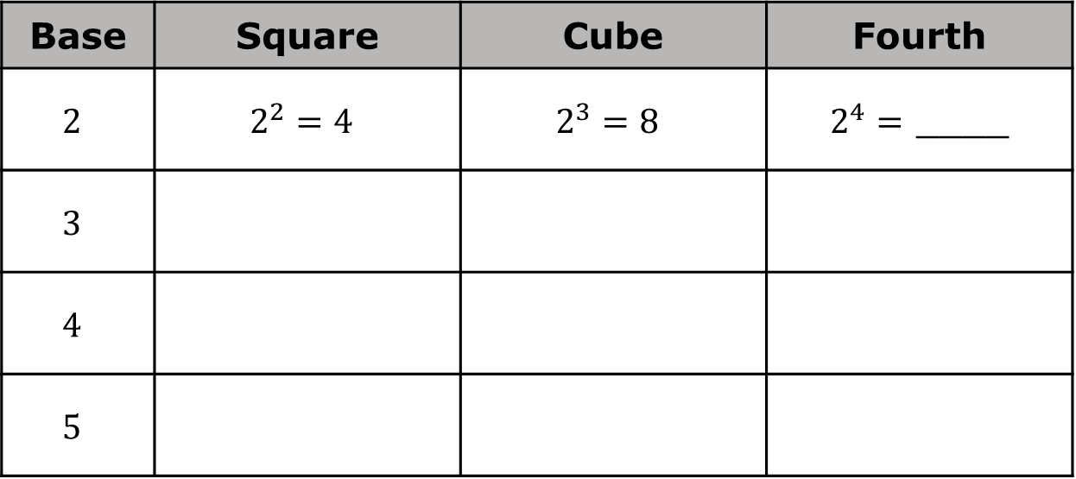
Complete the table. The first row is started for you.
Base | Square | Cube | Fourth
$$2$$ | $$2^{2}=4$$ | $$2^{3}=8$$ | $2^{4}=$ ____
$$3$$
$$4$$
$$5$$
volume 1, pg. 149

Slide 13
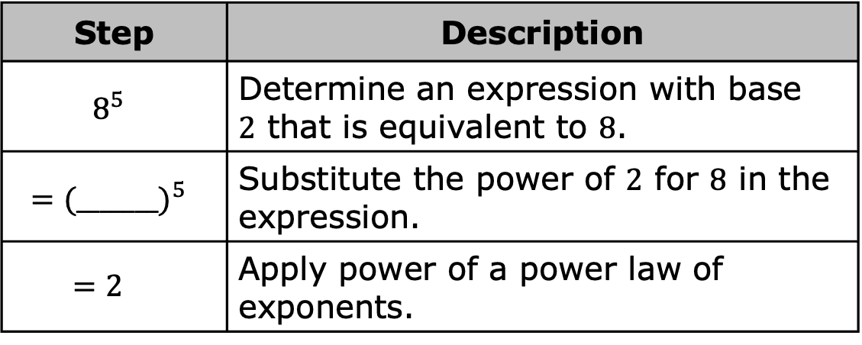
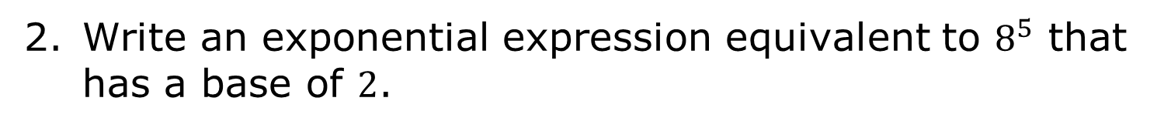
Write an exponential expression equivalent to $8^{5}$ that has a base of $2$.
Step | Description
$$8^{5}$$ | Determine an expression with base $2$ that is equivalent to $8$.
$$={(_______)}^{5}$$ | Substitute the power of $2$ for $8$ in the expression.
$$=2$$ | Apply power of a power law of exponents.
volume 1, pg. 149

Slide 14
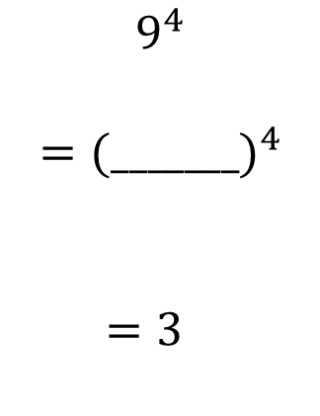
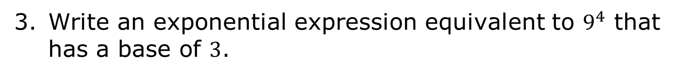
Write an exponential expression equivalent to $9^{4}$ that has a base of $3$.
$$9^{4}$$ $$={(_______)}^{4}$$ $$=3$$
volume 1, pg. 149

Slide 15

Complete the steps to write an exponential expression equivalent to $2^{3}·4^{3}$ that has a base of $2$.
$2^{3}·4^{3}$
$$=2^{3}∙{\left( \right)}^{3}$$
$$=2^{3}∙2$$
$$=2$$
volume 1, pg. 149

Slide 16
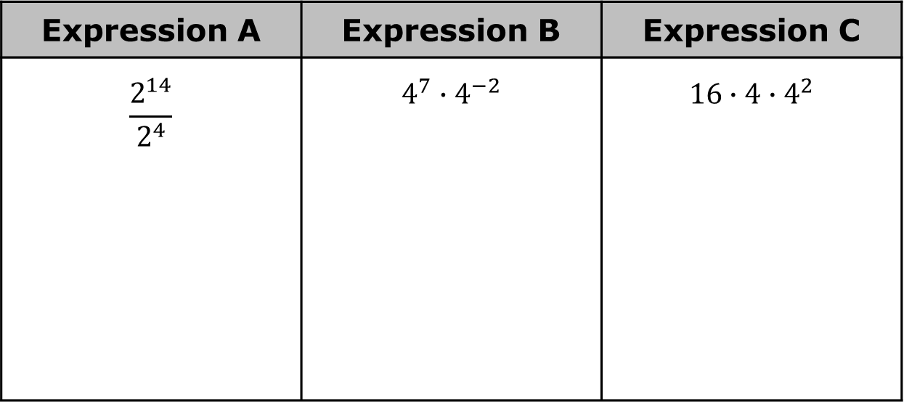
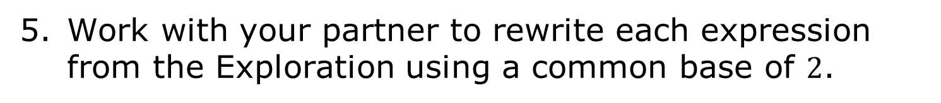
Work with your partner to rewrite each expression from the Exploration using a common base of $2$.
Expression A | Expression B | Expression C
$$\frac{2^{14}}{2^{4}}$$ | $$4^{7}∙4^{−2}$$ | $$16∙4∙4^{2}$$
volume 1, pg. 149

Slide 17

Guided Practice
volume 1, pg. 150

Slide 18

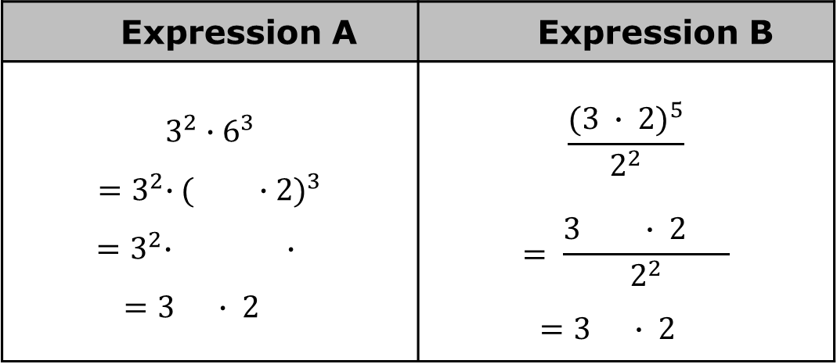
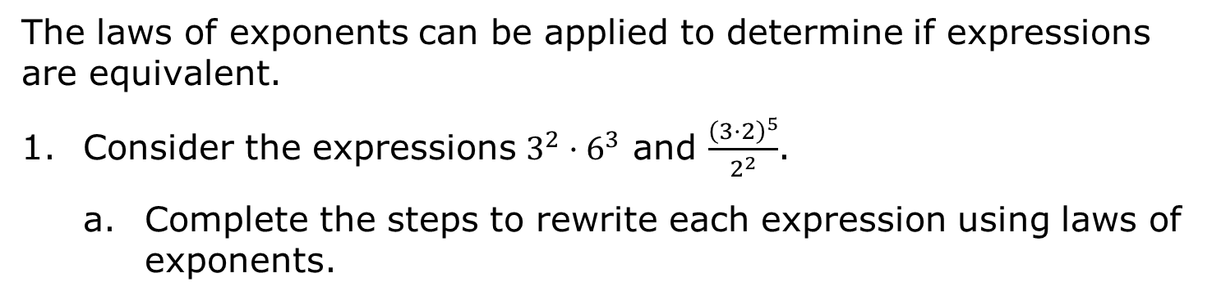
4.6.4 Guided Practice: Different Bases, Same Value
The laws of exponents can be applied to determine if expressions are equivalent.
Consider the expressions $3^{2}·6^{3}$ and $\frac{{\left(3·2\right)}^{5}}{2^{2}}$.
Complete the steps to rewrite each expression using laws of exponents.
Expression A | Expression B
$3^{2}∙6^{3}$ ${=3}^{2}∙{( ∙2)}^{3}$ ${=3}^{2}∙ ∙$ $=3 ∙ 2$ | $$\frac{{(3 ∙ 2)}^{5}}{2^{2}}$$ $$= \frac{3 ∙ 2 }{2^{2}}$$ $=3 ∙ 2$
volume 1, pg. 150

Slide 19
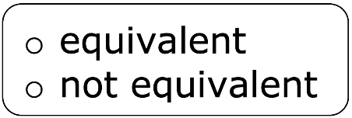
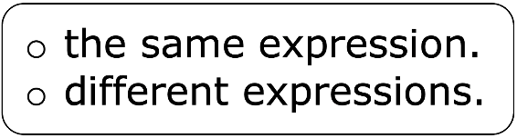
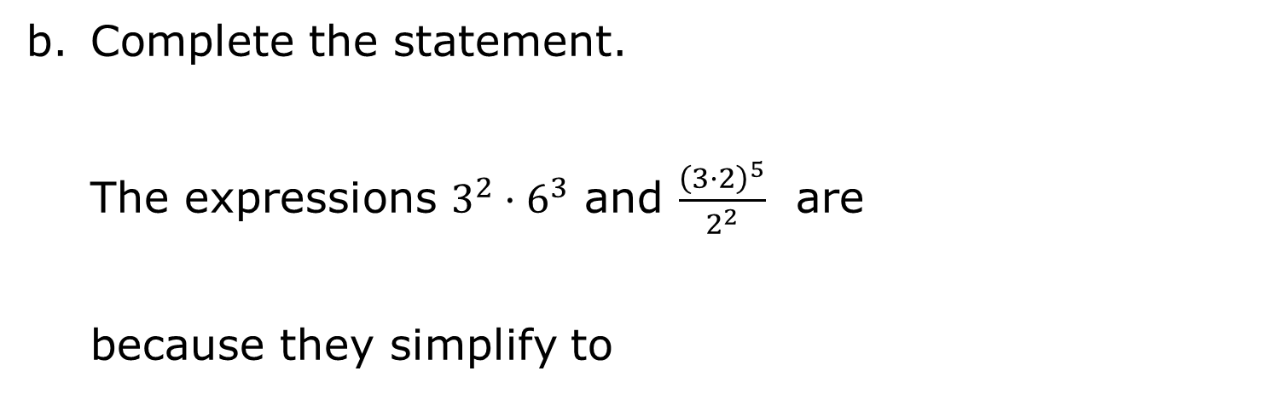
Complete the statement.
The expressions $3^{2}·6^{3}$ and $\frac{{\left(3·2\right)}^{5}}{2^{2}}$ are because they simplify to
volume 1, pg. 150

Slide 20
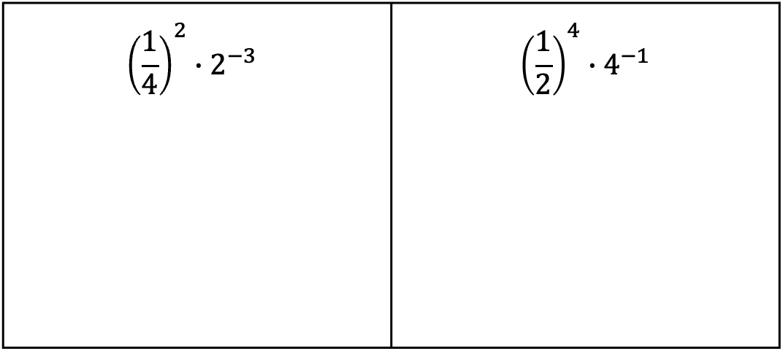
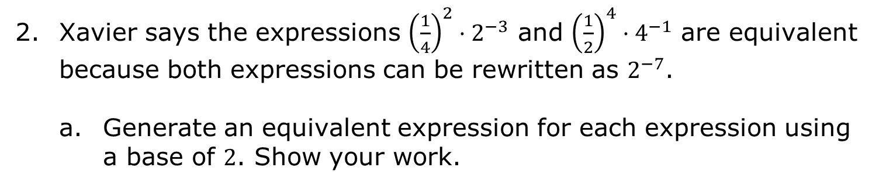
Xavier says the expressions ${\left(\frac{1}{4}\right)}^{2}·2^{−3}$ and ${\left(\frac{1}{2}\right)}^{4}·4^{−1}$ are equivalent because both expressions can be rewritten as $2^{−7}$.
Generate an equivalent expression for each expression using a base of $2$. Show your work.
$${\left(\frac{1}{4}\right)}^{2}∙2^{−3}$$ | $${\left(\frac{1}{2}\right)}^{4}∙4^{−1}$$
Explain whether or not you agree with Xavier.
volume 1, pg. 150

Slide 21

Collaboration
volume 1, pg. 151

Slide 22

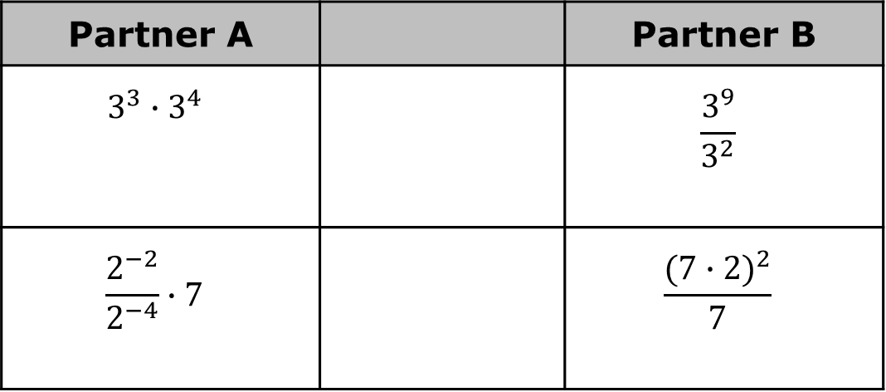
4.6.5 Collaboration: Equivalent Expressions
With your partner, determine who is Partner A and who is Partner B.
Generate an equivalent exponential expression for each expression in your column using as few bases as possible.
Partner A |  | Partner B
$$3^{3}∙3^{4}$$ |  | $$\frac{3^{9}}{3^{2}}$$
$$\frac{2^{−2}}{2^{−4}}∙7$$ |  | $$\frac{{(7∙2)}^{2}}{7}$$
volume 1, pg. 151

Slide 23
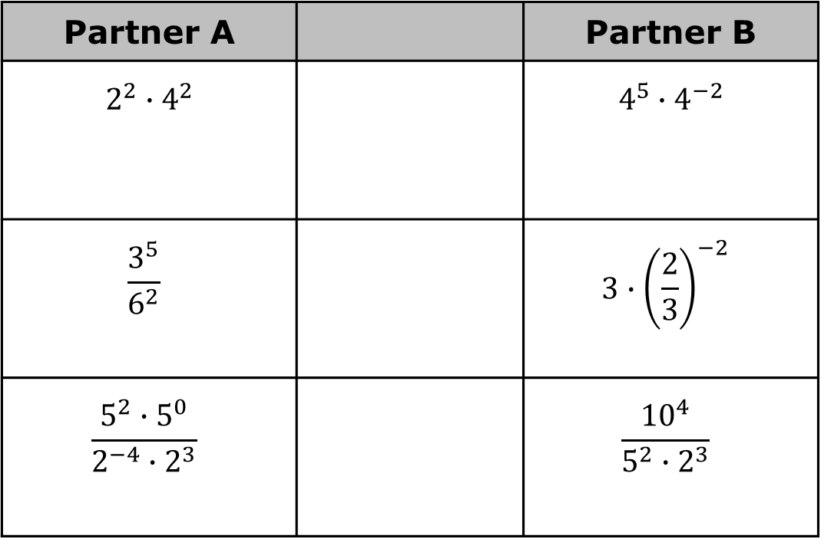
Partner A |  | Partner B
$$2^{2}∙4^{2}$$ |  | $$4^{5}∙4^{−2}$$
$$\frac{3^{5}}{6^{2}}$$ |  | $$3∙{\left(\frac{2}{3}\right)}^{−2}$$
$$\frac{5^{2}∙5^{0}}{2^{−4}∙2^{3}}$$ |  | $$\frac{{10}^{4}}{5^{2}∙2^{3}}$$
volume 1, pg. 151

Slide 24
The expressions in each row are equivalent. If your expression and your partner’s expressions are not equivalent, work together to find and correct any error(s). Then, write the equivalent expression in the middle column.
volume 1, pg. 151

Slide 25

Wrap-Up
volume 1, pg. 152

Slide 26
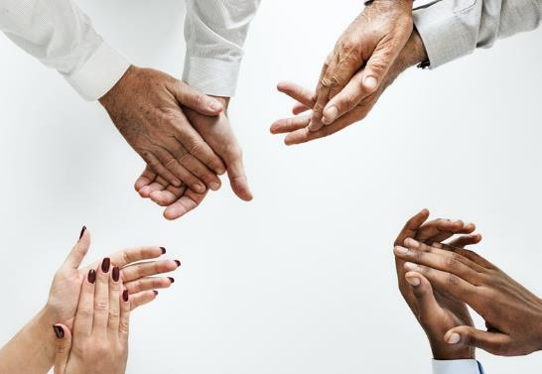
4.6.5 Wrap-Up: Reflection
Complete the table as you reflect on today’s lesson.
Today I deserve for …
volume 1, pg. 152

Slide 27
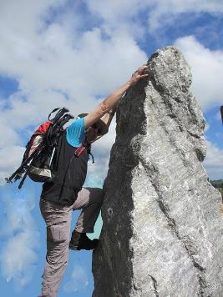

Today I by doing …
Today I was by …
volume 1, pg. 152

